Slide 1

many-to-many Relationship
Infoway Technologies, 3rd Floor Commerce Centre, Rambaug Colony, Paud Road Pune 411038

Slide 2
many-to-many Relationship
A many-to-many relationship is a type of cardinality that refers to the relationship between two entities A and B in which A may contain a parent instance for which there are many children in B and vice versa.
Infoway Technologies, 3rd Floor Commerce Centre, Rambaug Colony, Paud Road Pune 411038

Slide 3
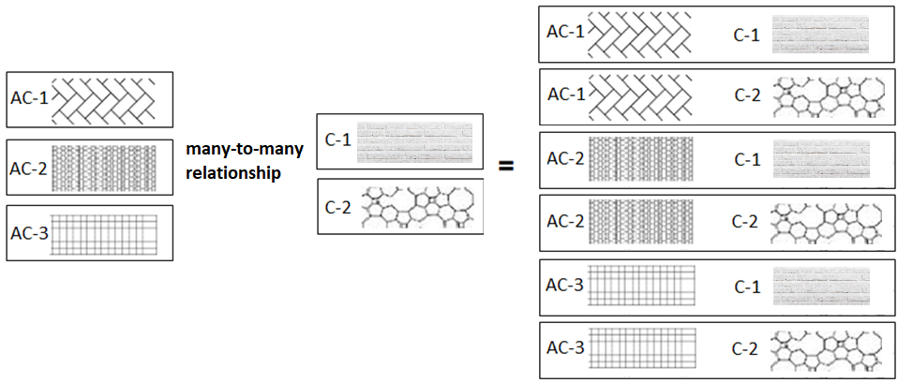
many-to-many relationship
A many-to-many relationship is a type of cardinality that refers to the relationship between two entities[ A and B in which A may contain a parent instance for which there are many children in B and vice versa.
Infoway Technologies, 3rd Floor Commerce Centre, Rambaug Colony, Paud Road Pune 411038

Slide 4
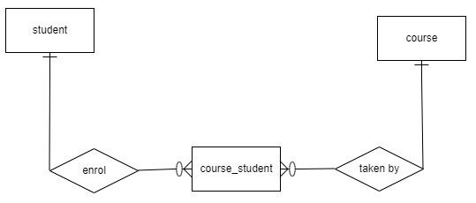
many-to-many relationship
CREATE TABLE student (
ID INT(11) PRIMARY KEY,
firstName VARCHAR(45),
lastName VARCHAR(45),
DoB DATE,
emailID VARCHAR(145)
);
CREATE TABLE course (
ID int(11) PRIMARY KEY ,
name varchar(45),
duration int(11),
summery varchar(1024)
);
CREATE TABLE course_student (
ID INT(11) PRIMARY KEY,
studentID INT NOT NULL,
courseID INT NOT NULL,
foreign key (studentID) references student(ID),
foreign key (courseID) references course(ID)
);
Infoway Technologies, 3rd Floor Commerce Centre, Rambaug Colony, Paud Road Pune 411038

